Slide 1
My Neighbor Totoro: A Timeline of Japanese Modern History
By: Sarah Brown
Outreach Coordinator
Carolina Asia Center

Slide 2
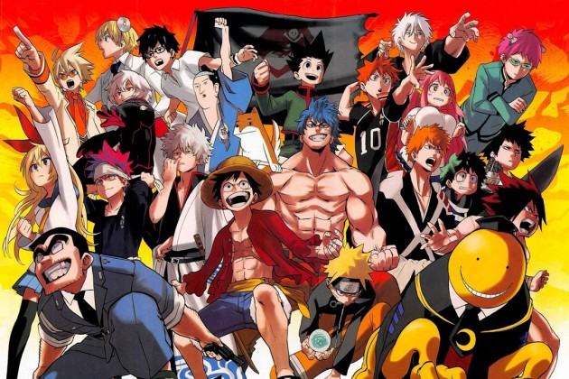
Manga

Slide 3
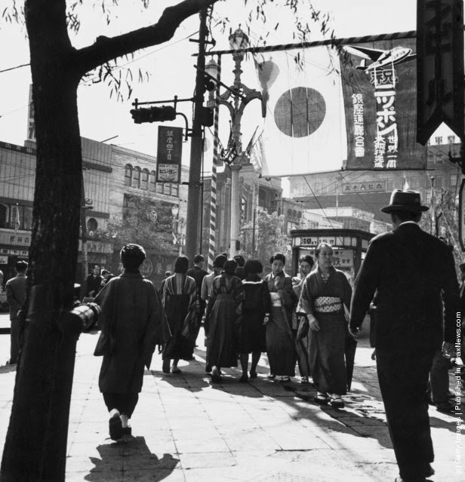
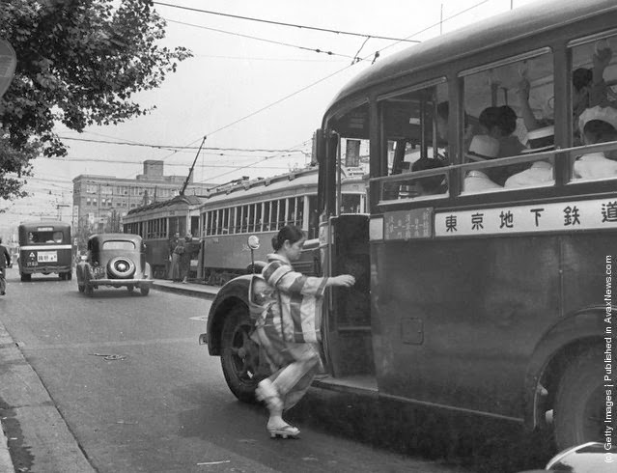
1950’s Japan Think- Pair- Share
Notes:
Source of picture on left: Pedestrians in Tokyo's Ginza district, circa 1950. (Photo by Evans/Three Lions/Hulton Archive/Getty Images)
Source of picture on right: A woman, in traditional dress of kimono and platform shoes, boards a bus, Japan, circa 1950. (Photo by Frederick L. Hamilton/Three Lions/Hulton Archive/Getty Images)
http://www.vintag.es/2013/12/black-white-photos-of-japan-from-1950s.html

Slide 4
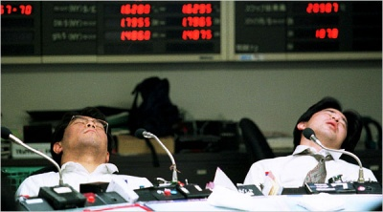
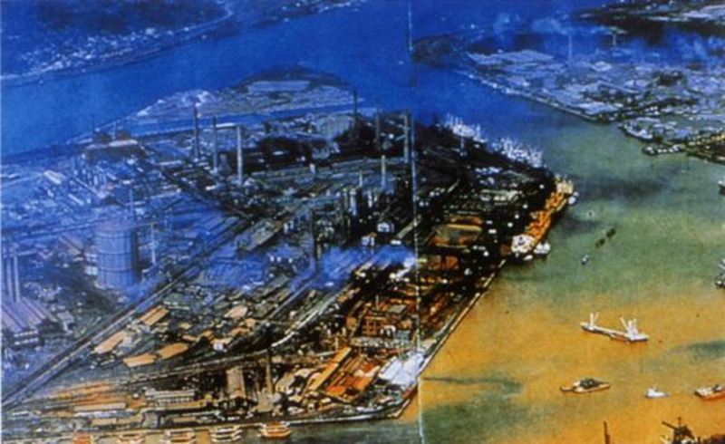
1990’S Japan Home Video
What’s the Same?
What’s Different?
Notes:
Watch about 30seconds
Video by Lyle Hiroshi Saxon

Slide 5
PROJECT: Build a Timeline
Get into groups of 3-4 so there are 8 groups
Look at handout and choose one of the topics that your group will research
US-Japan Mutual Security Treaty and other US relations in the 1950s
Economic Growth in the 1950s
The royal family as the "professional housewife" and "salaryman" in the 1960s
Olympic Games held in Tokyo and the television in 1964
Pollution-Related Health Damage Compensation Law in 1972
Japanese car firm Honda opens its first plant in the US in 1982
Japanese Education in 1980s, and burst of the Japanese economic bubble in 1990
Use any TRUSTED resources (documents, good websites (not wiki), and the helpful sources on the page to help research.
Find 3 pictures, graphs, cartoons, or any visual artifact and put it on a PowerPoint slide (or google slide). Write a paragraph to accompany it and turn it in. Instructions on worksheet.

Slide 6
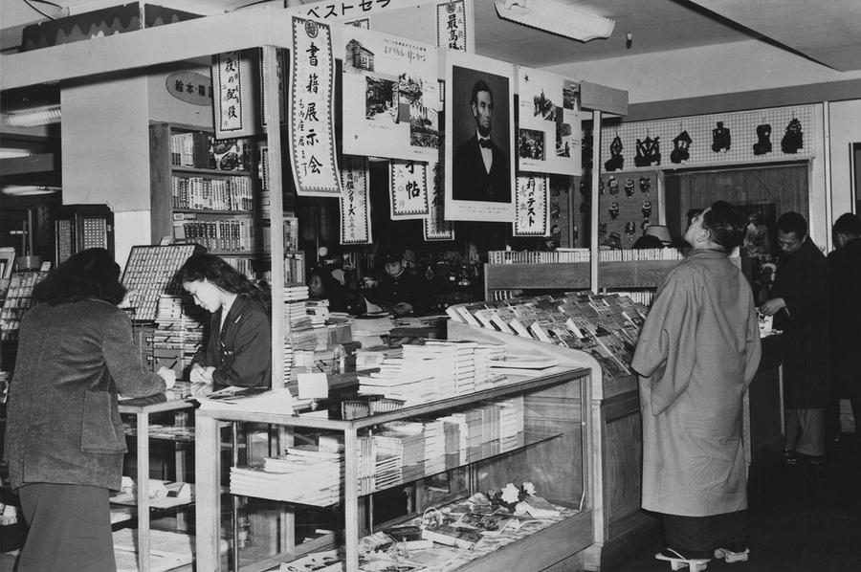
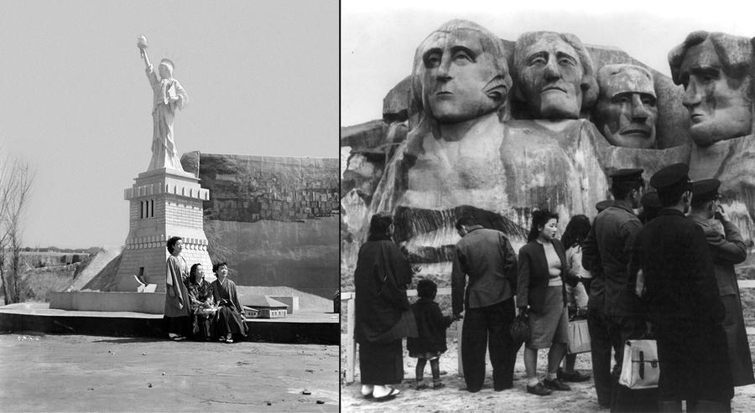
What was the effect of the US-Japan Mutual Security Treaty
Sets the stage for high economic growth
Democratic Japan
Japan as US ally in the Cold War
Okinawa
Article 9
*Can you spot a US president?
Notes:
Source for pictures: The Atlantic https://www.theatlantic.com/photo/2014/03/japan-in-the-1950s/100697/
1. “Interior of a Tokyo department store in 1959, where a Japanese man wearing Geta, traditional wooden footwear, looks up at a poster-sized portrait of Abraham Lincoln hanging with two other posters about Lincoln's life.”
2. “At the "America Fair". Left: Three kimono clad Japanese girls sit at the base of a reproduction of the Statue of Liberty at the America Fair, which opened in Osaka, Japan, on March 25, 1950. Right: A replica of the Mt. Rushmore memorial in South Dakota, one of the exhibits portraying U.S. history and notable scenes at the America Fair. The fair portrayed "significant events in American history and followed the growth of the United States to its current standards of efficiency in sciences, industry and agriculture.“”

Slide 7
Economic Growth: Yoshida Doctrine (1950-1973)
Main Objective: Growth
Involvement in international political affairs should be avoided
To guarantee security, Japan will rely on US bases
Keep military expenses low
Notes:
Source: Dr. Elyssa Faison University of Oklahoma

Slide 8
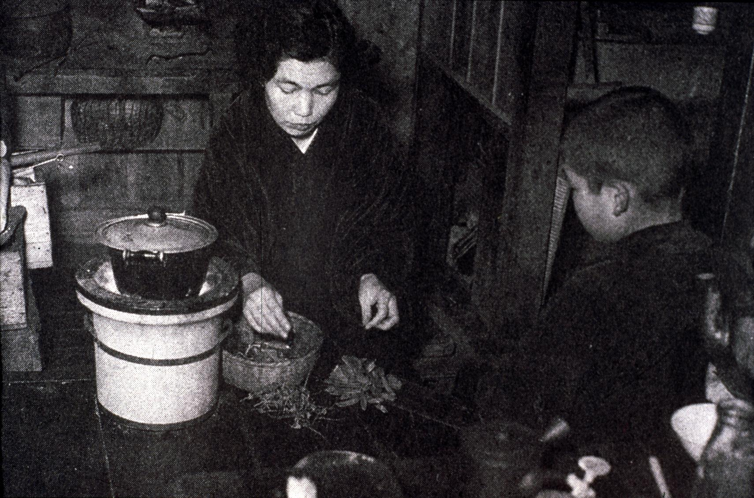
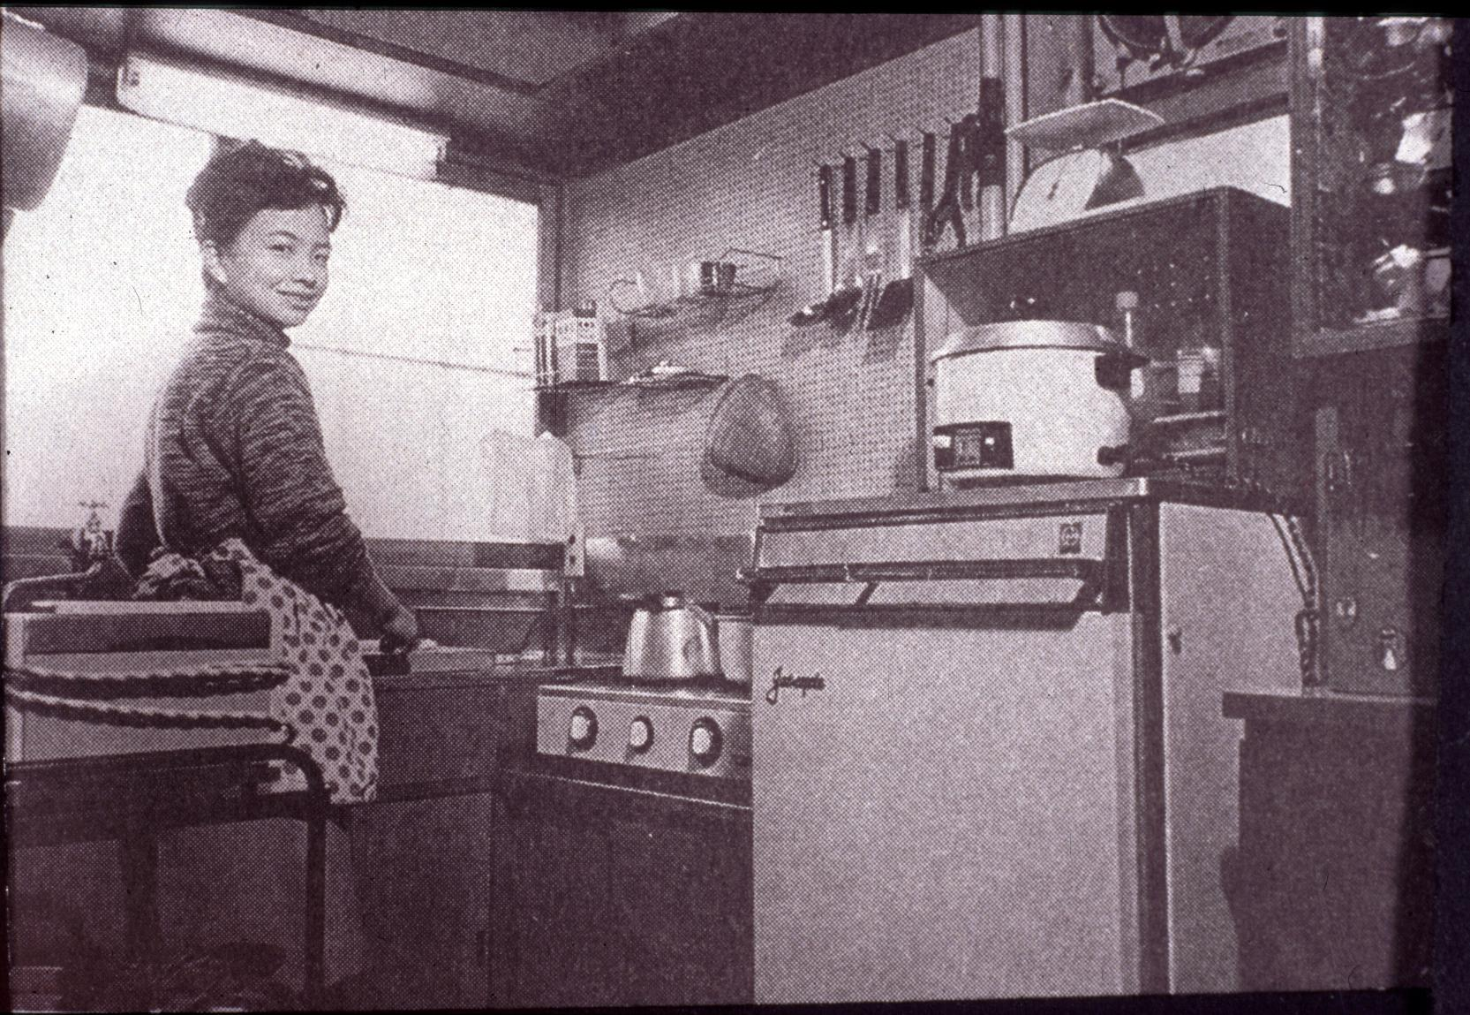
Modern Luxuries of the 1950s
Notes:
Source for both pictures: UNC professor’s powerpoint
Old Kitchen versus New.

Slide 9
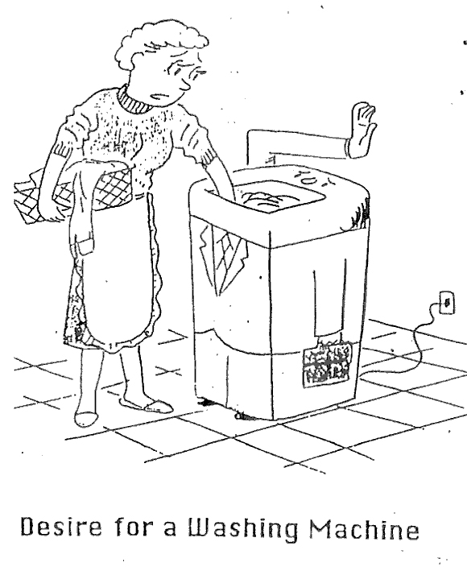
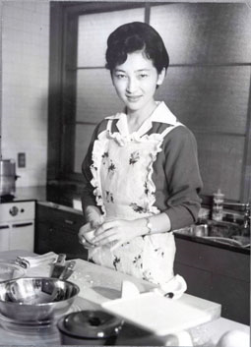
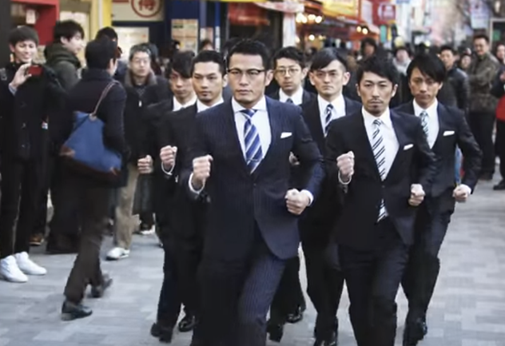
Professional HouseWife and SalaryMan
Okabe Fuyuhiko, 1956
Notes:
Source all three pictures: UNC Professor’s powerpoint- In 1960, Michiko gave birth to the first of her three children. Prince Naruhito will soon become the Emperor of Japan. In the early 1960s, photos of Michiko cooking in her kitchen in the palace and taking care of her children herself gave a new shine to the image of the modern mother. It was an image mixed with fashion and celebrity. Akihito seemed to stand in as the royal equivalent of the salaryman
Salary Man Picture
Comic by Okabe Fuyuhiko depicting the professional housewife and the salary man turned into the machine

Slide 10
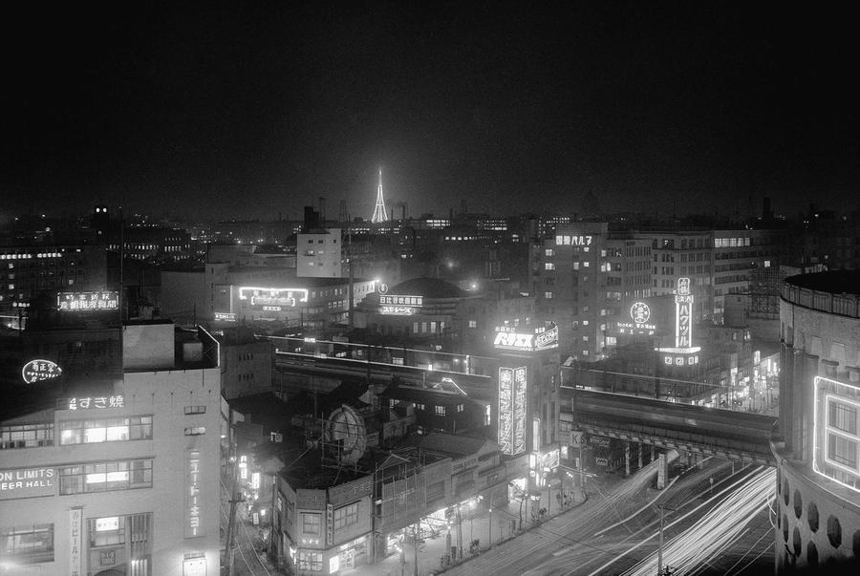
The Rise of Television
Notes:
Source picture on right: The Atlantic
“Ten thousand photo flashbulbs lit up a new television station and tower in downtown Tokyo on March 26, 1955, in what was called the biggest flash shot in the world. Radio Tokyo, in connection with a local flashbulb company, exploded the 10,000 bulbs on its new 516-foot television antenna to remind Tokyoites that it would begin telecasting on April 1. Thousands of camera fans crowded upper story windows and roof tops near the TV station to photograph the spectacle”
Source picture on left: UNC Professor’s powerpoint - “The 1959 wedding festivities were televised, making this royal family more accessible and more glamorized than royals of the past. More and more people purchased a TV set, leading to a new kind of mass culture in Japan. “ –Dr. Jan Bardsley

Slide 11
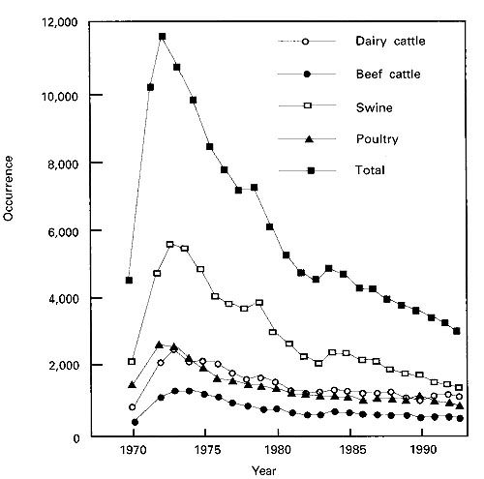
Pollution in 1970-1980
Notes:
Source picture on left: Japan Focus “Industrial pollution in Dokai Bay, 1960s”
http://apjjf.org/2012/10/42/Carin-Holroyd/3844/article.html
Source picture on right: Food and Fertilizer Technology Center for the Asia and Pacific Region: Figure 1 Occurrence of Pollution Problems from Animal Wastes in Japan, 1970-1993
http://www.fftc.agnet.org/library.php?func=view&id=20110729164127&type_id=4

Slide 12
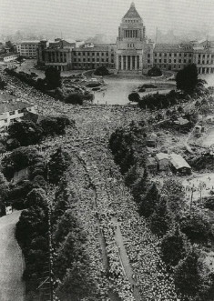
US-Japan Mutual Security Treaty Resigning
Notes:
Source: A UNC Professor’s powerpoint- Protest against USA-Japan Security Treaty ANPO (Nihibei Anzen Hoshō Jūyaku) in front of the Diet, Tokyo, June 15, 1960

Slide 13
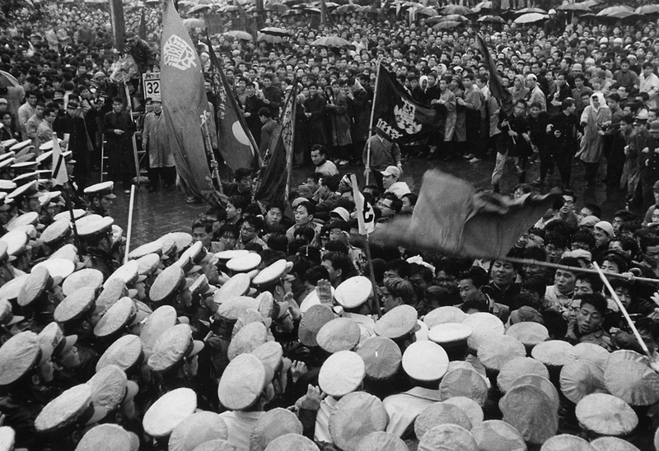
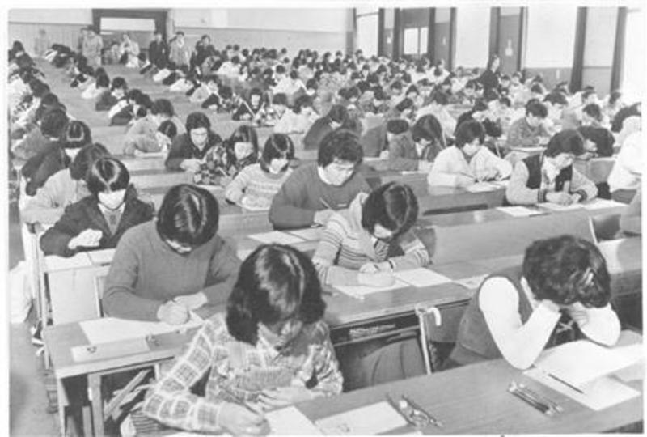
Japanese Education
Notes:
Source picture on left and right: Japan Focus “Japan’s 1968: A Collective Reaction to Rapid Economic Growth in an Age of Turmoil
http://apjjf.org/2015/13/11/Oguma-Eiji/4300.html

Slide 14
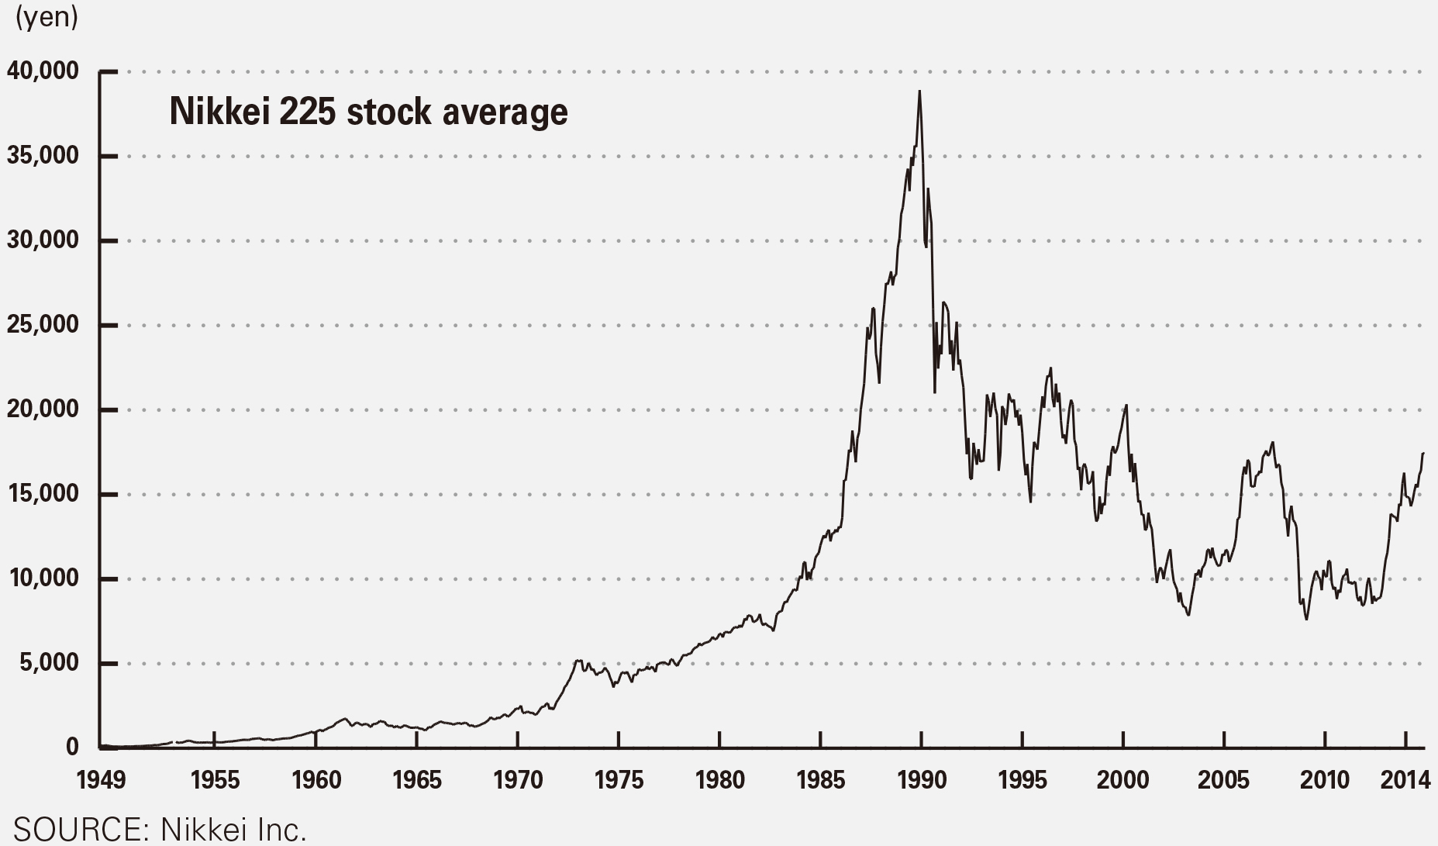
Economic Growth
Notes:
Source picture on left: Japan Times “Numbers Tell Tale of Japan’s Postwar Rise and Fall” http://www.japantimes.co.jp/news/2015/01/05/national/numbers-tell-tale-japans-postwar-rise-fall/#.WVFGW2grK70
“In the meantime, the 1949-2014 graph for the Nikkei stock average shows the rise and fall of the economy since the war. After the Nikkei’s establishment in May 1949, it ended its first year at ¥109.91.”
Source picture on right: Cutting Edge News “Must America Learn Painful Lessons from Japan’s Economic Crisis?”
http://www.thecuttingedgenews.com/index.php?article=1070

Slide 15
My Neighbor Totoro (1988)

